Slide 1
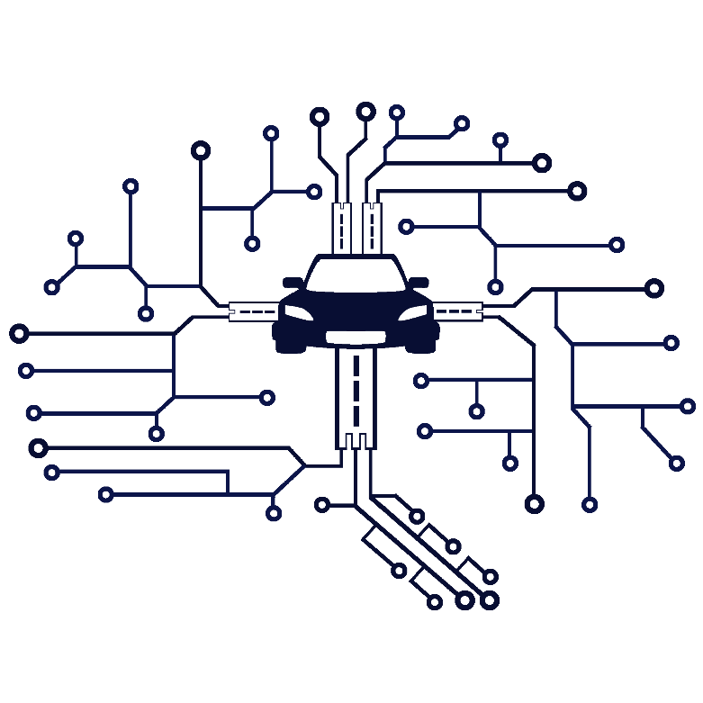
Smart Traffic System
Supervisors :
Dr. Mohamed Ramadan Saady
Assi.prof. Amany Ashraf Salamah
Team Members :
Hassan Ibrahim Mohamed
Abdelrahman Abdelrahim Mostafa
Essam Khairy Dahy
Abdelrahim Saad Abdelrahim

Slide 2
Project analysis slide 2
Content
Problem
Solutions
Architecture of the system
Limitation
Future work
Conclusion

Slide 3
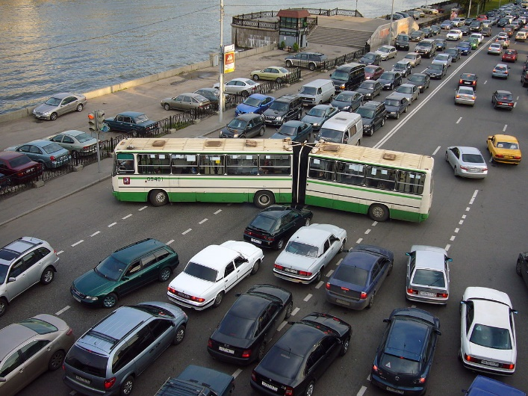
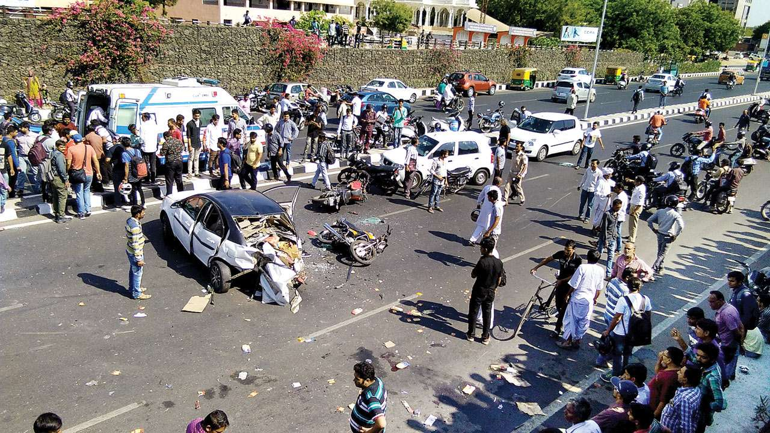
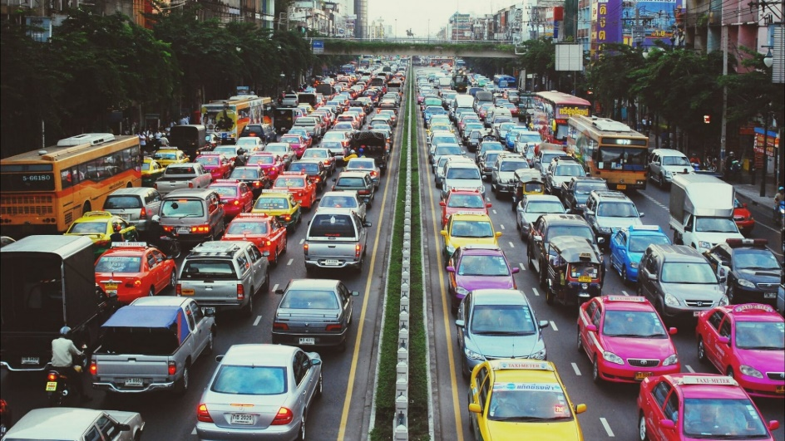
Project analysis slide 2
What is the problem?
Humans problem accidents Huge Number of cars

Slide 4
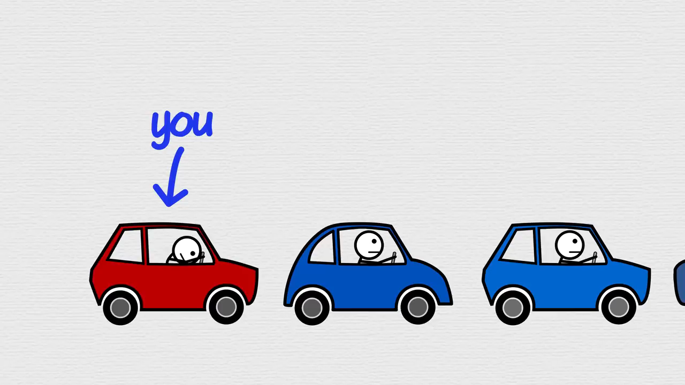
How the problem happens!

Slide 5
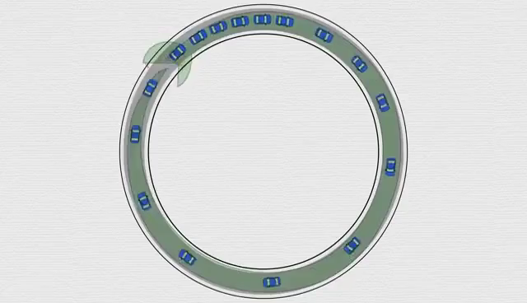
con.. (Traffic snake visualized)

Slide 6
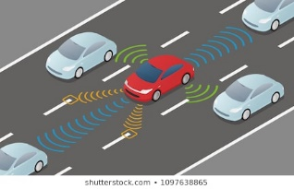
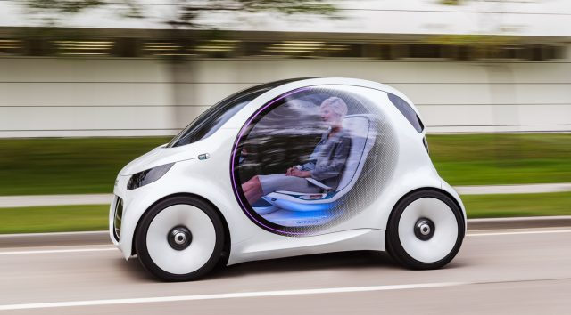
Project analysis slide 2
Previous works
V2V self-driving cars

Slide 7


Project analysis slide 2
Proposed solution
Hypothesis:
Remove the humans from driving the car ➔ self-driving car
Self-driving cars connected with each other ➔ IOT
Manage the flow of cars ➔ Artificial Intelligence “reinforcement learning model ”
Proposed solution introduction:
What makes a traffic problem-free?
How to make the decision that the previous question answers?
What makes a good route?
Proposed solution:
The self-driving cars (human replacements) integrated on an IOT-managed traffic system.
All the data are updated real-time with the database.
Building a reinforcement learning agent and connecting the database to learn from the data on it.
The environment is the city consisting from streets that have different qualities and the agent explore the environments through the cars while they’re moving.
Every time a car wants to go somewhere the agent tell it what is the best route to their.
The agent know what is the best route depending on pre calculated value.
The value calculated after the agent analyze the every street using the data the cars are sending.

Slide 8


Smart Traffic system components
3 main elements:
The Reinforcement learning model
(The agent)
The communication channel
(APIs)
The traffic world replacement
(simulation)

Slide 9
Agent
How the agent tells the cars how to go somewhere (give it a route to the destination):
1- The agent take the request from the car and prepare the needed data.
2- The agent calculate the route depending on these data.
3- The agent after calculating the best route, it makes an estimation about where the car will be and when to use this information in future calculations.
4- After a car finish any street it send a report and send it to the agent, so the agent analyse it and update the value that describe how good this street is.

Slide 10
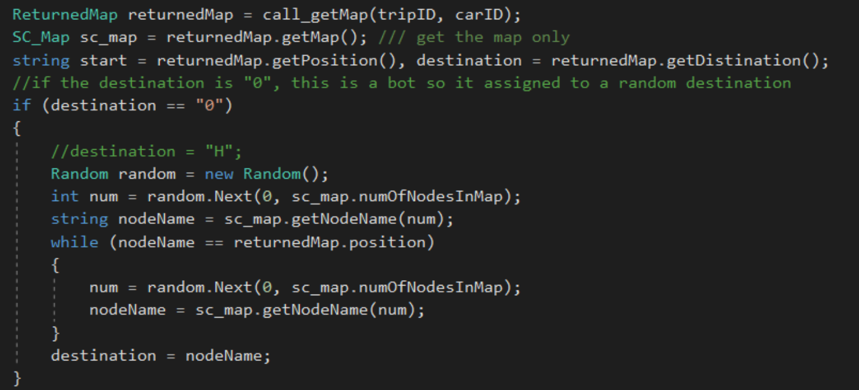
Agent (cont.)
1- Getting request and preparing data

Slide 11
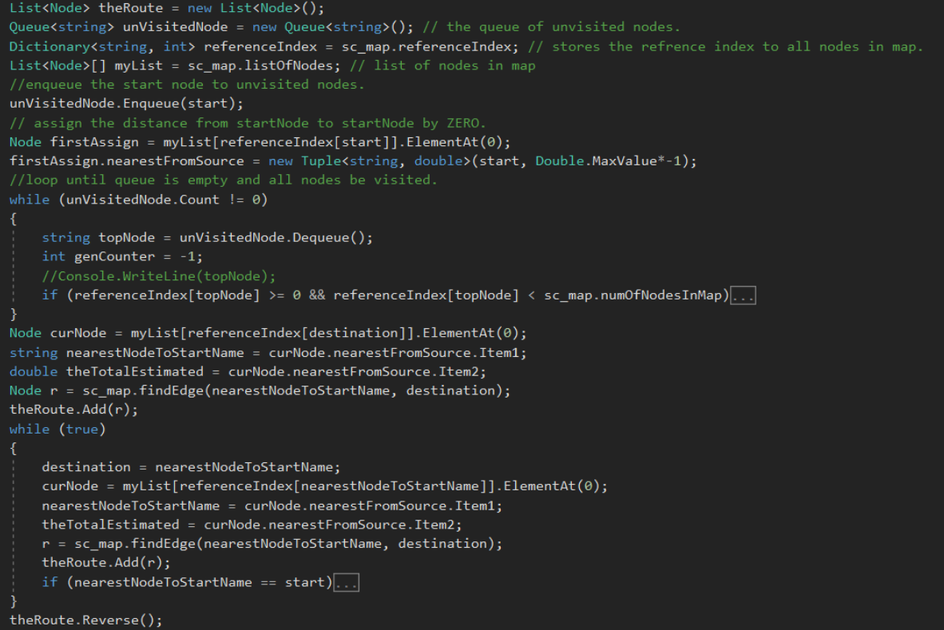
Agent (cont.)
2- Calculating the route

Slide 12
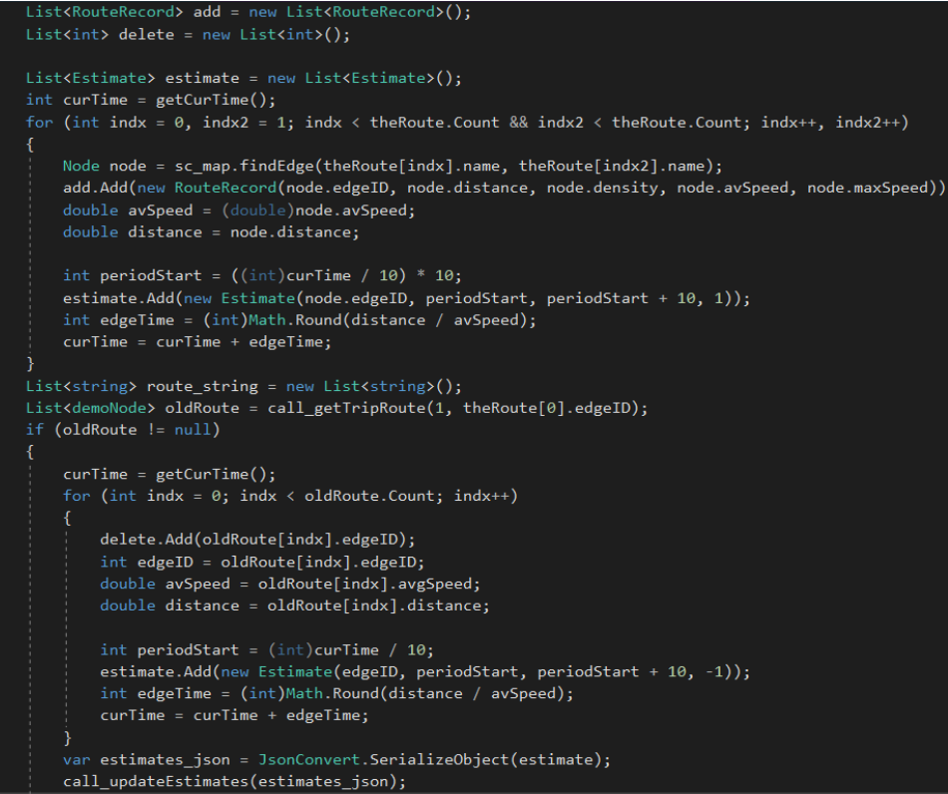
Agent (cont.)
3- Making the estimates

Slide 13
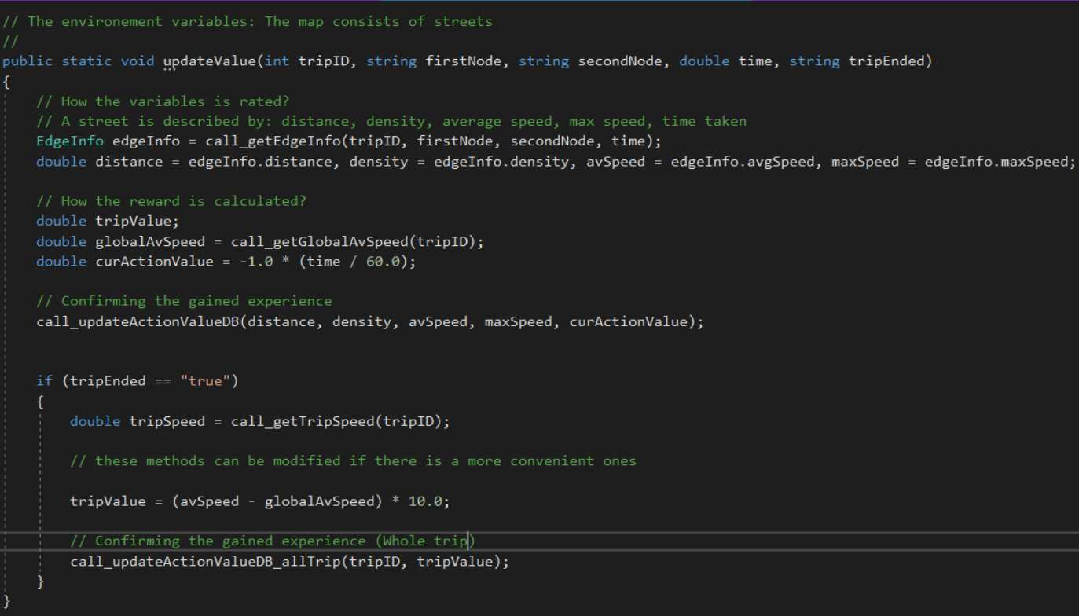
Agent (cont.)
4- Getting report and updating the experience

Slide 14
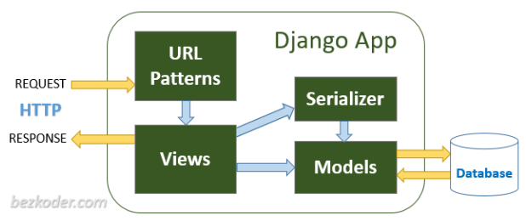
API (Communication channel)
Python Django Framework and Django REST framework
What is rest API?
what is Django framework?
why Django framework?

Slide 15
Main Functions of APIs:
Get Map: return all edges of map.
Trip Initiation: create trip and return tripID
Get Trip Route: return Route to the car
Update Edge Estimates: update number of cars on each edge
Update Average Speed: update average of edges
Car Live Data: get car live data
Update Route: update trip route
Select Action Value: return reward of edge
Update Action Value For Car: update reward action value of edge
Update Action Values For All Trip: update reward of trip

Slide 16
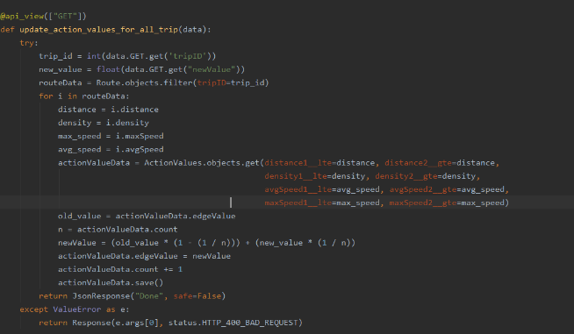
Update Action Values For All Trip:

Slide 17

Simulation
How Trips get Handled in the Simulation :
Initiate Trip
Requesting The Agent For a Route
Handling The Path
Switching Between Targets
Car Live Data Sharing
Sending Report At Reaching Every Node

Slide 18
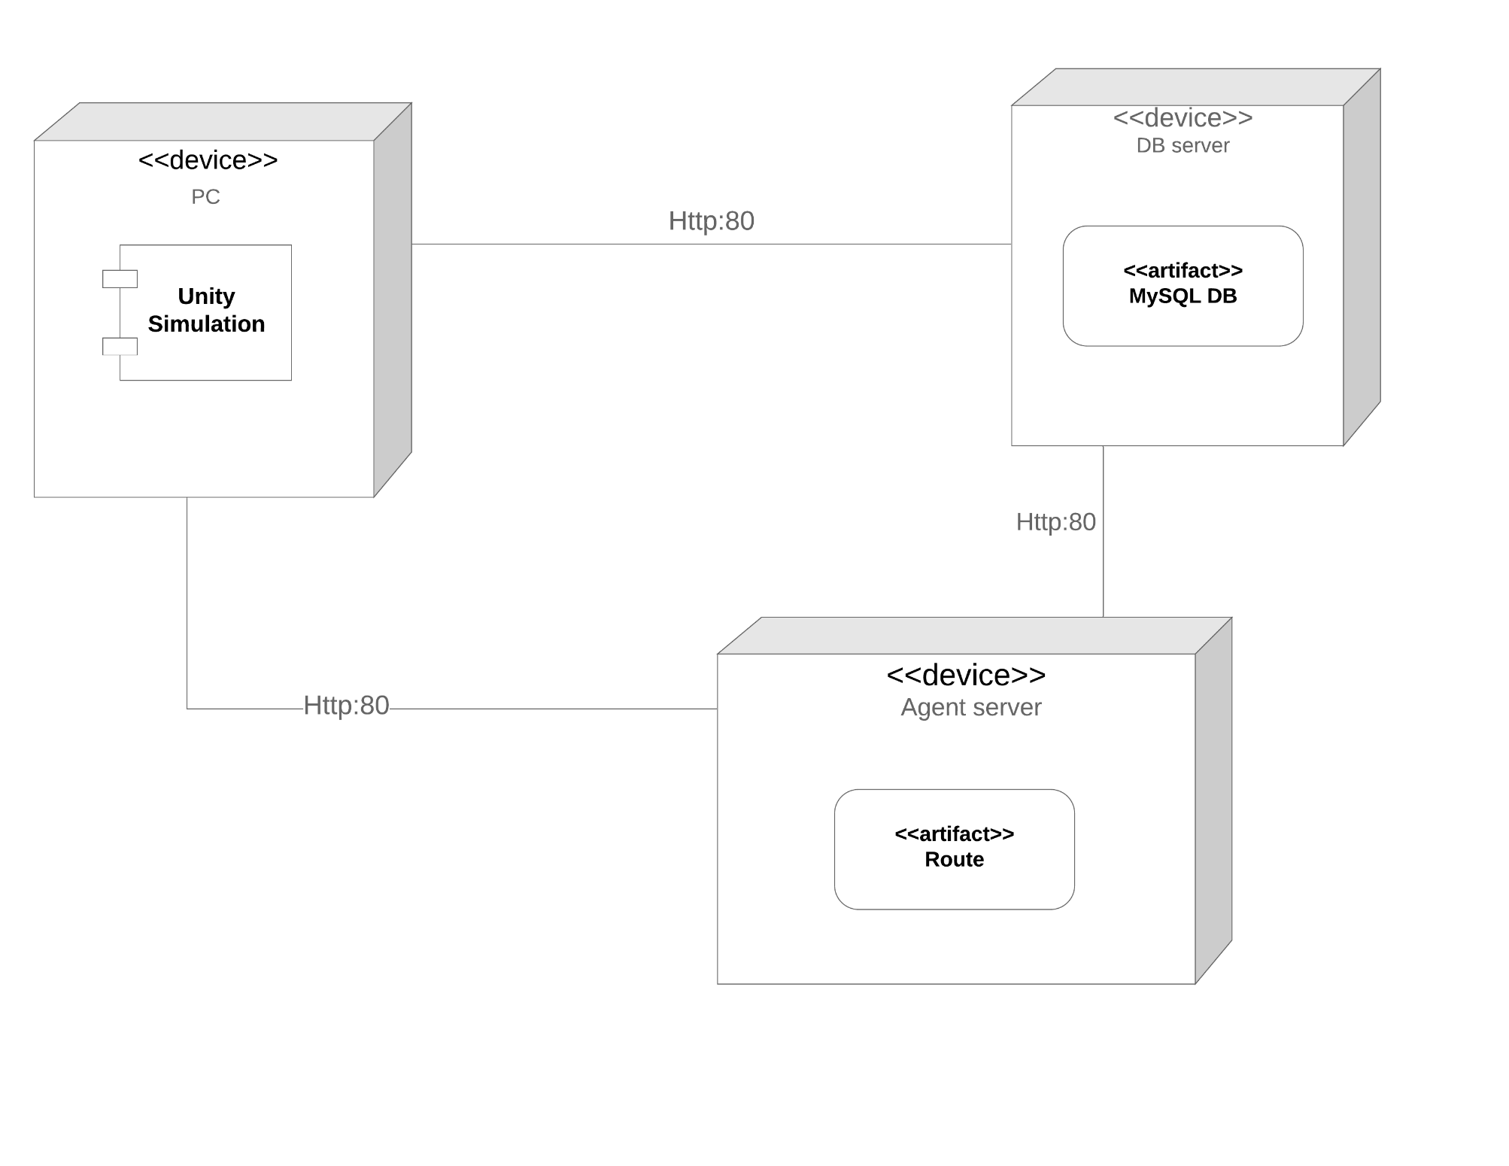
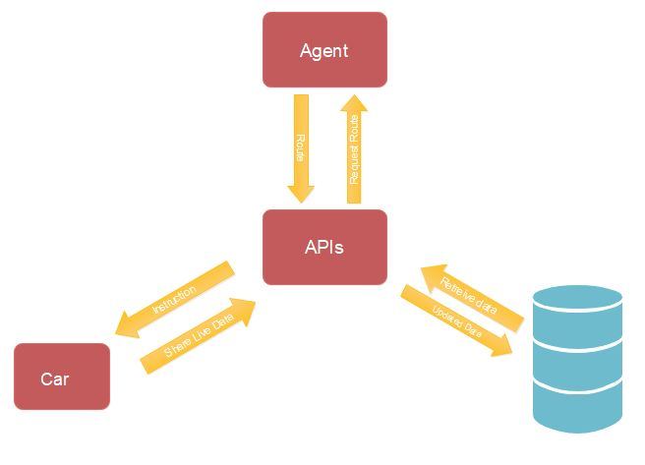
Project analysis slide 2
System Architecture & Deployment
Design of the system , how components will interact with each other.

Slide 19
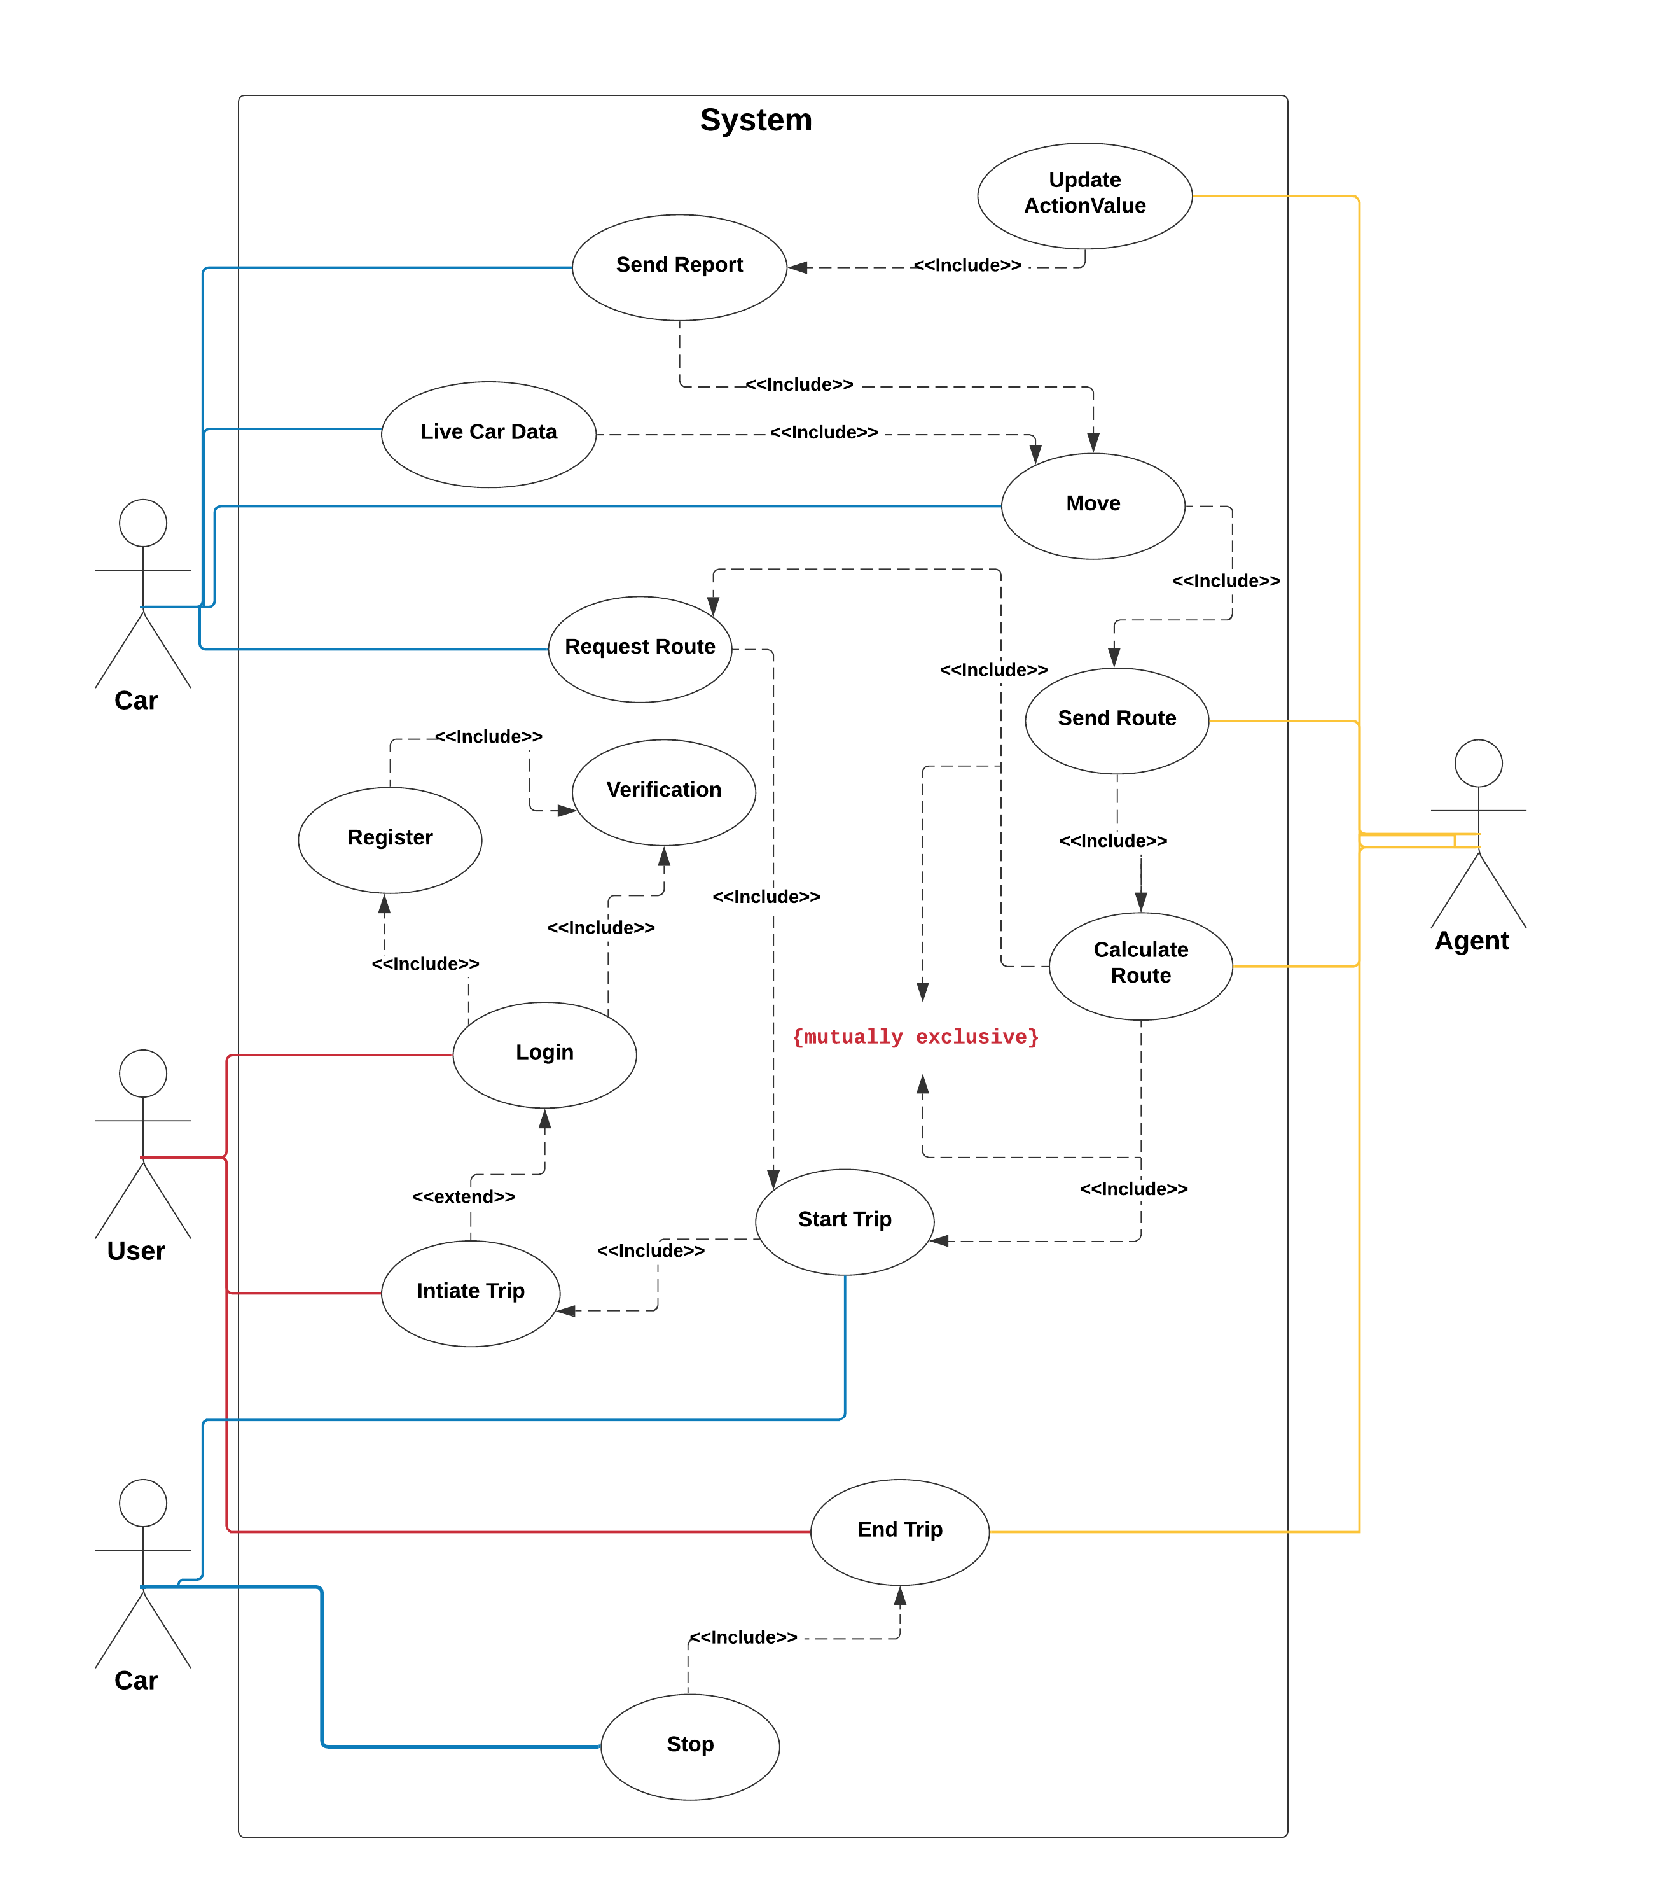
Use case
Live car data: car’s exact position.
Agent: The reinforcement learning model
Route: The list of edges that the Agent sends to a cars in order to move according to it to reach the destination.
Action value: value that describe an edge state.

Slide 20
Project analysis slide 5
Expected results
After (certain amount of time) the number of trips expected to be completed is (1000), with an average that each trip explore 10 actions, then number of actionValues that will be updated is 10,000.
Completed trip
Environment exploration
Average speed
1000
10,000
120 km/h
As the average that in a trip, 10 action values updated

Slide 21
Project analysis slide 2
Conclusion
How the proposed solution solved the solution?
As described earlier, the big problem that we can’t apply any solution to the traffic problems and expect it to succeed perfectly because of the human interaction; as the humans are not perfectly organized and will not always follow instructions, and have troubles coordinating with each other.
So the system first, solved that big problem by eliminating the human part so that any solution we propsed will be expected to work because AI can easily follow instructions.
Getting to the real solution for the problem; is integrating the system with a reinforcement learning agent. That guarantee that the system learn from its mistakes and after enough time the system become perfectly cabable of managing the traffic.
What is the different from the previous work?
The previous work gaps:
1- Working on a small range.
2- Cannot make real estimation AS the data is not 100 shared with the system, as we offer with IOT.
3- The human part is still there so the solutions cannot be applied perfectly
How to apply the system on real world?
The city must be allowed for only self0driving cars with a stable internet connections on them.
The streets must be well designed and have a soft description as a map.
A stable servers .

Slide 22
Thank You

